Slide 1

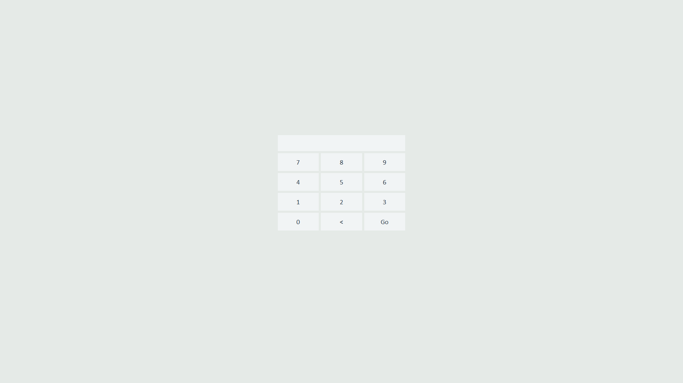
Enter Your ID

Slide 2

Clock In Here
Click Finish

Slide 3
12 Hours Later…

Slide 4
Enter Your ID

Slide 5

Clock Out Here

Slide 6
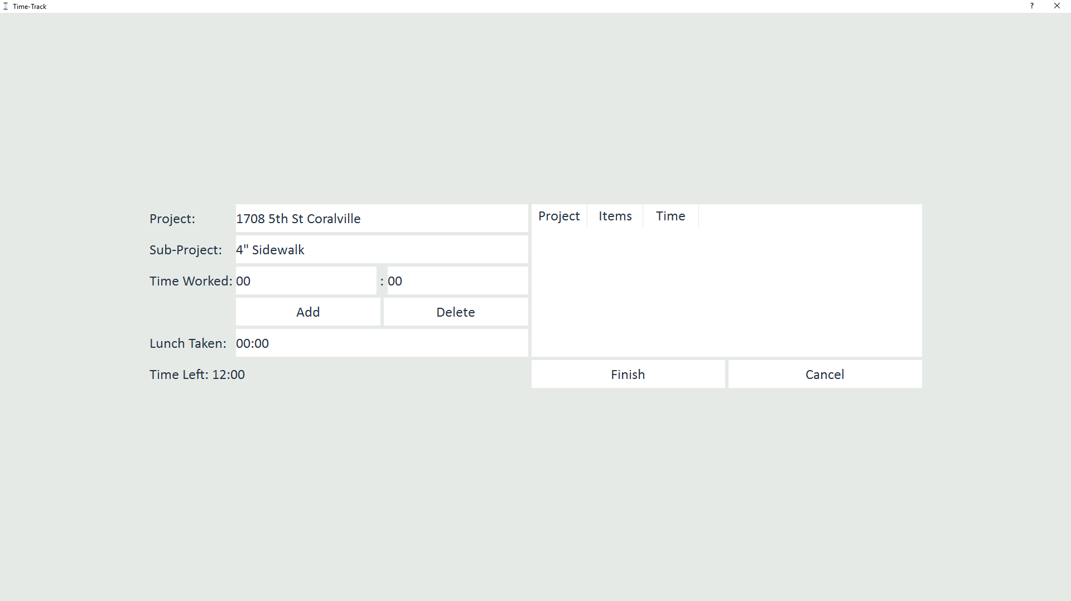
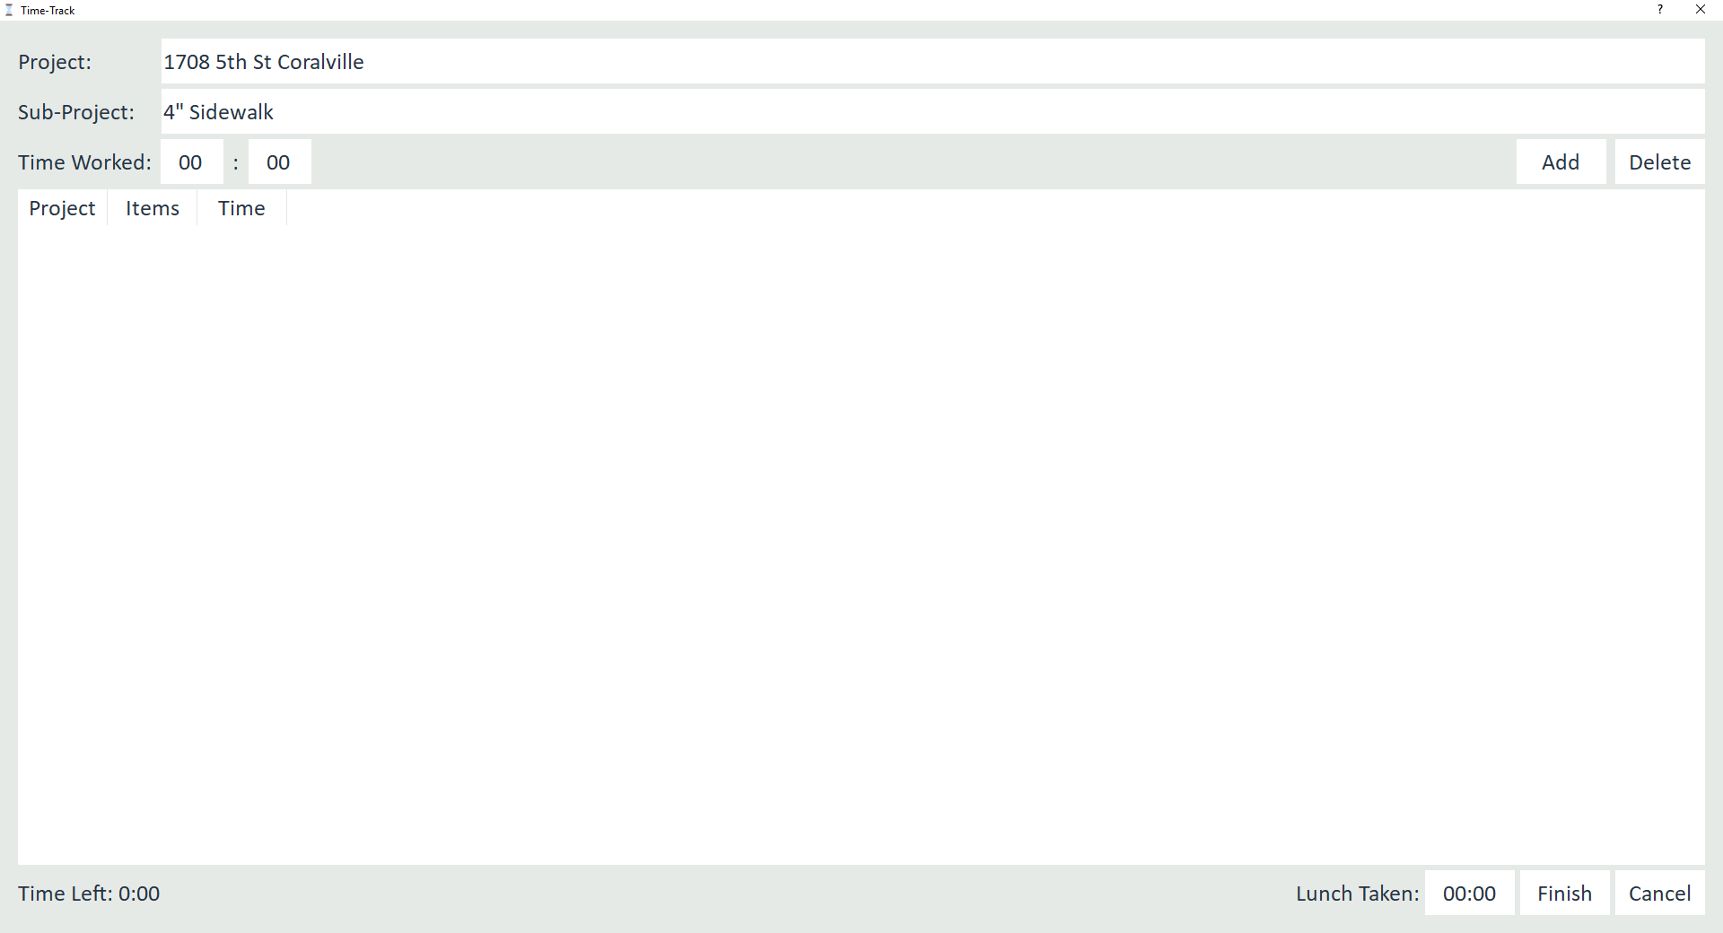
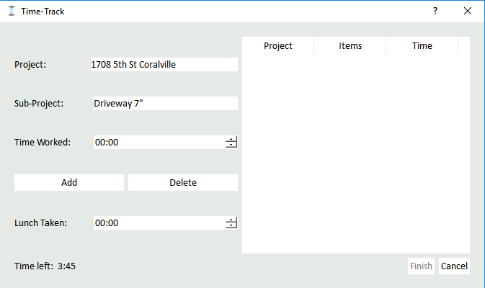
This is a Electronic time card

Slide 7

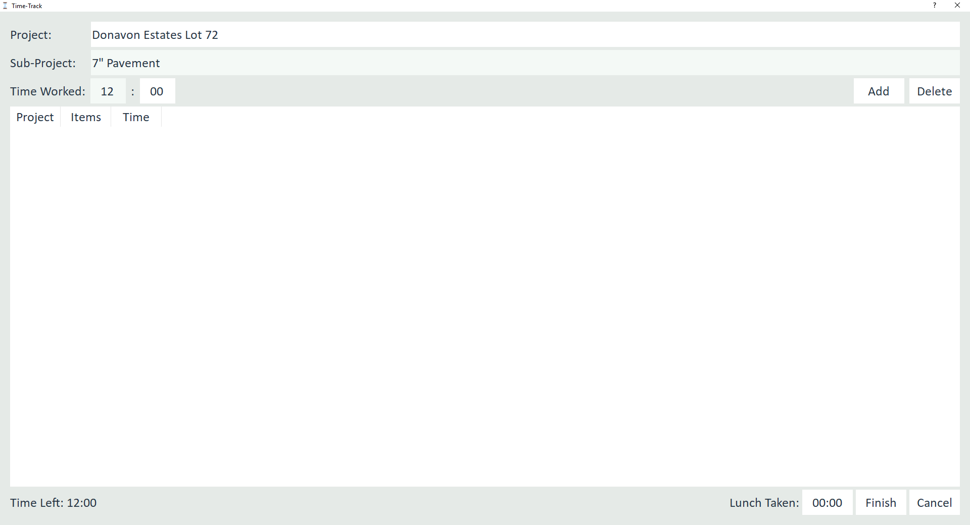
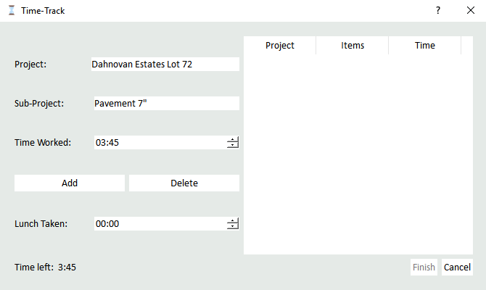
Select :
Where you worked
What you did
How much time you spent
Click Add to Add this info to your time card
Notice that the Time Left is now 12:00

Slide 8
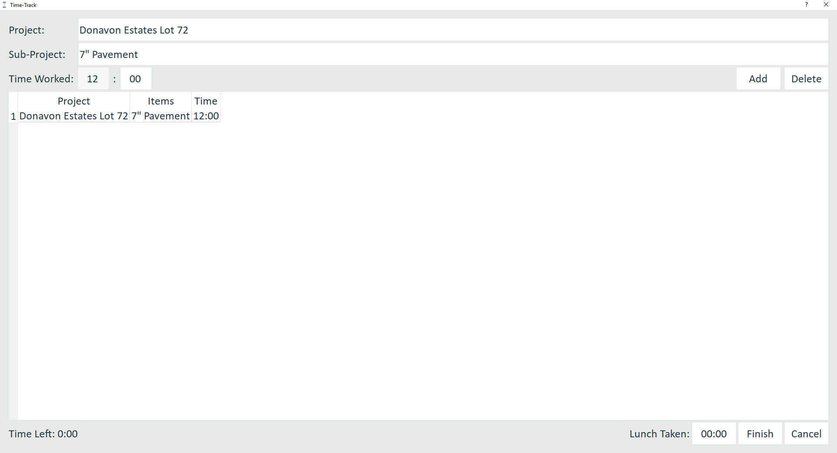
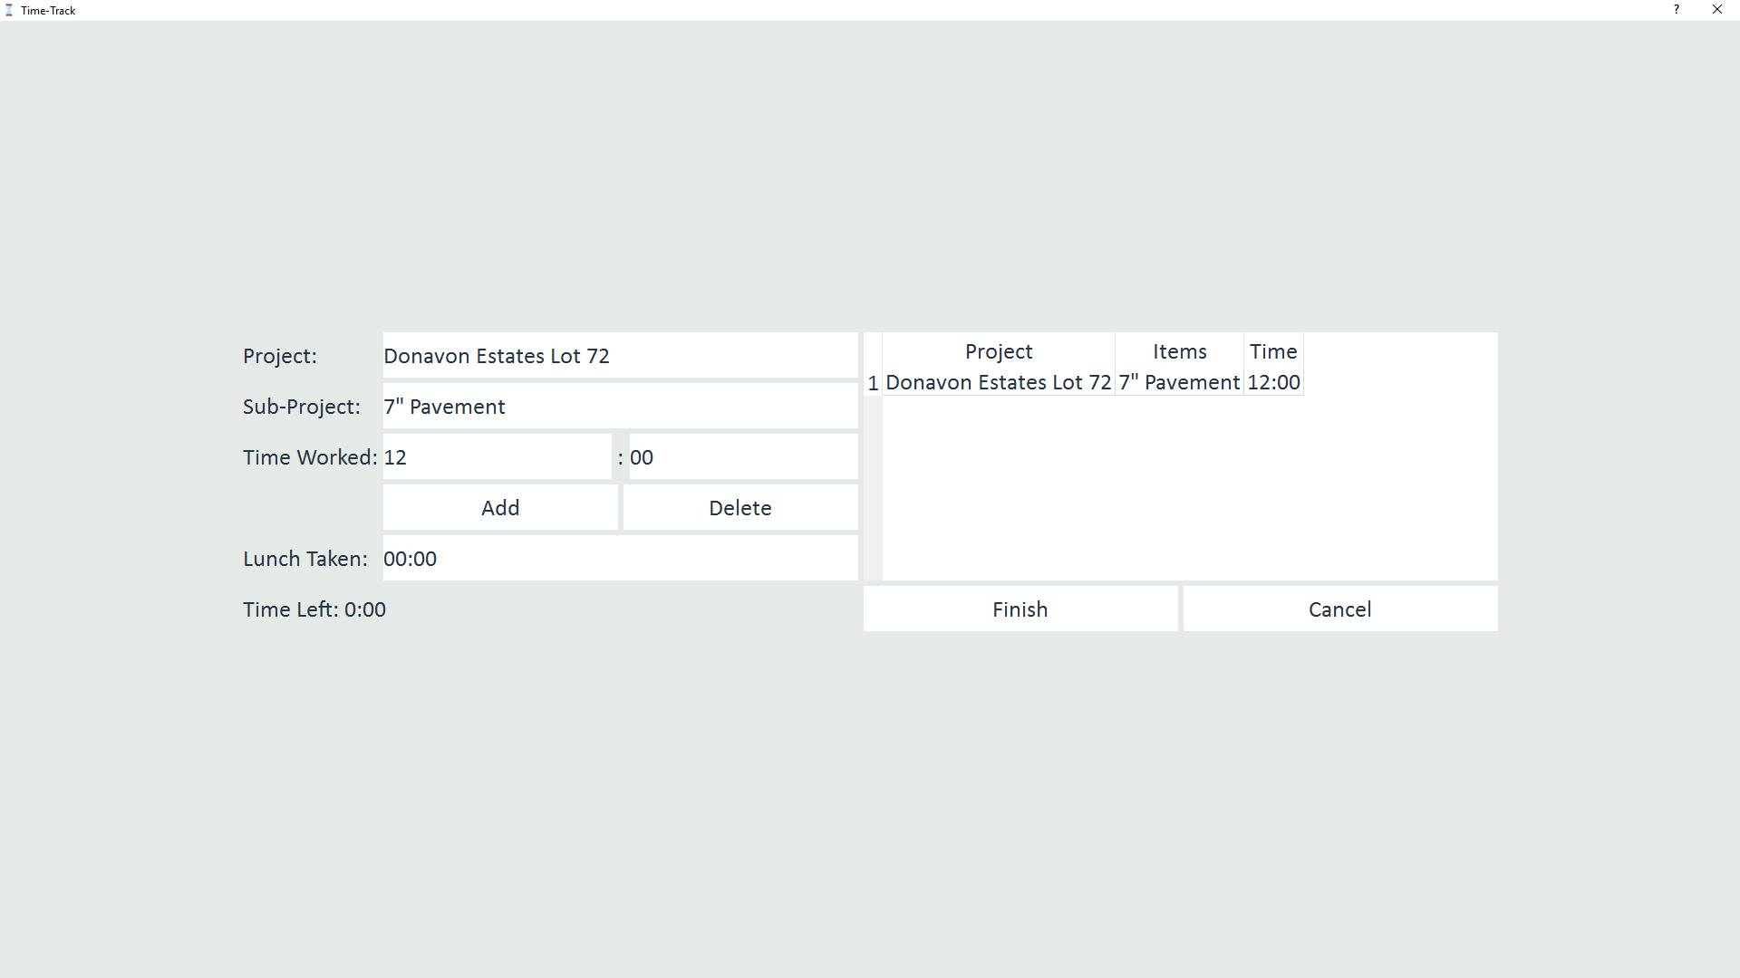
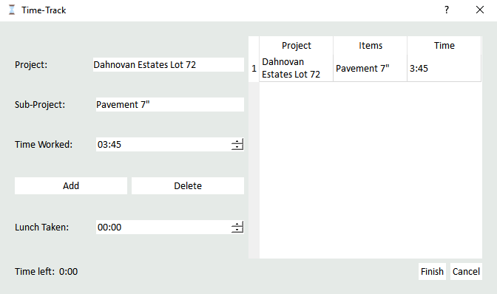
Now the info that we added in the last slide is displayed in the table
Time Left = Time Worked – Time On Sheet
Notice that the Time Left is now 0:00

Slide 9
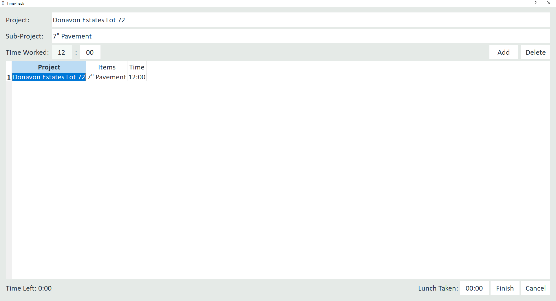
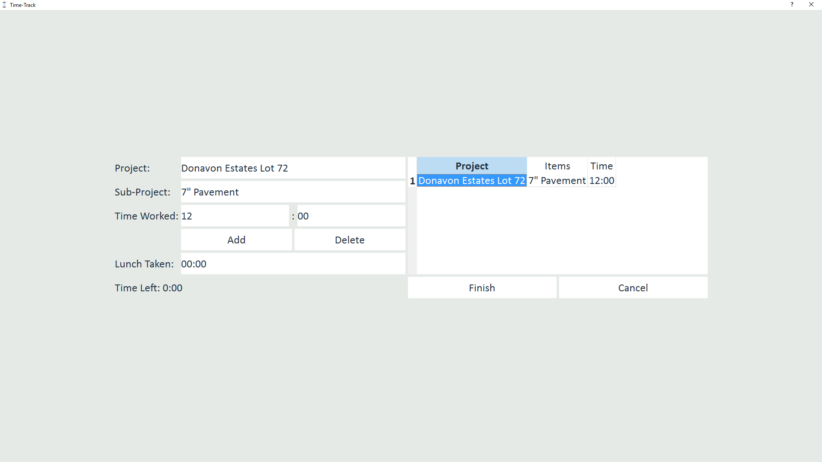
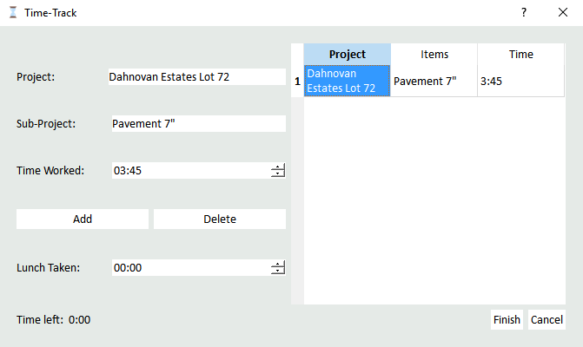
Lets say you entered the wrong Sub-Project
You worked on 5” Sidewalk not 7” Pavement
1. Select the entry you want to edit
2. Hit the Delete button

Slide 10
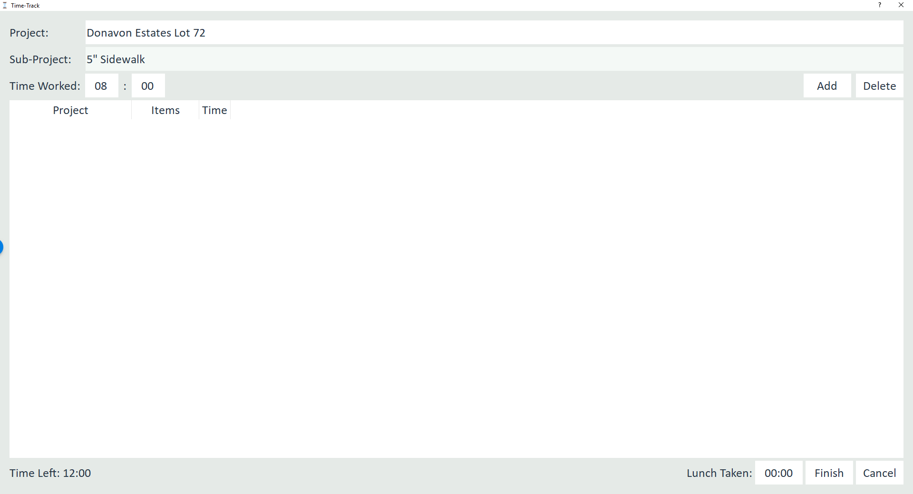
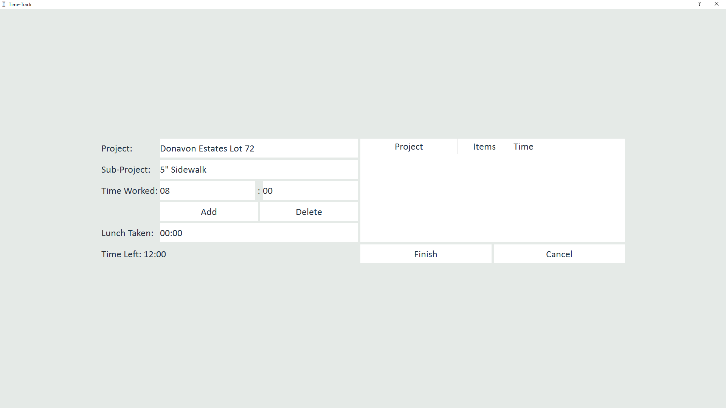
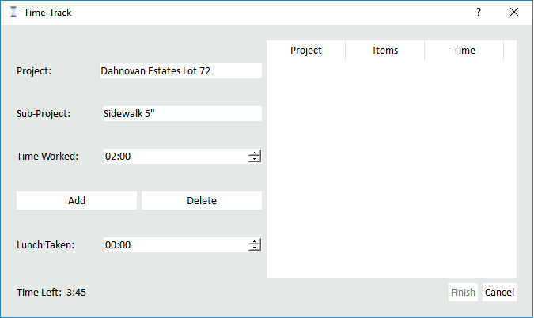
Now Your slate is clean so..
Select :
Where you worked
What you did
How much time you spent
Click Add to Add this info to your time card

Slide 11
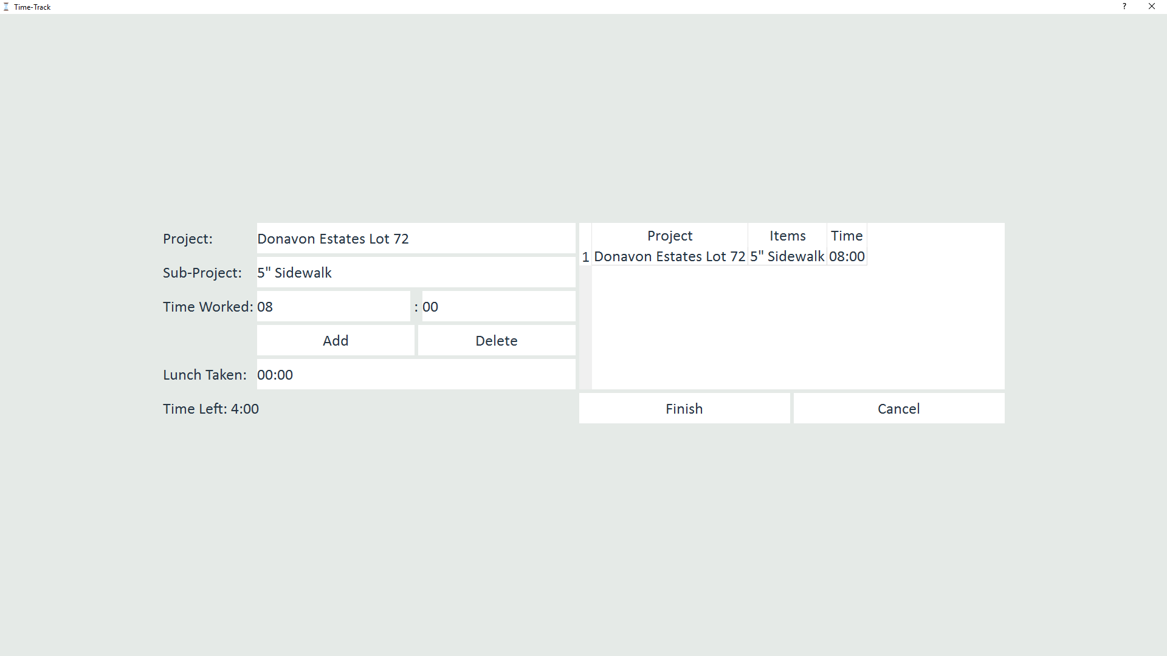
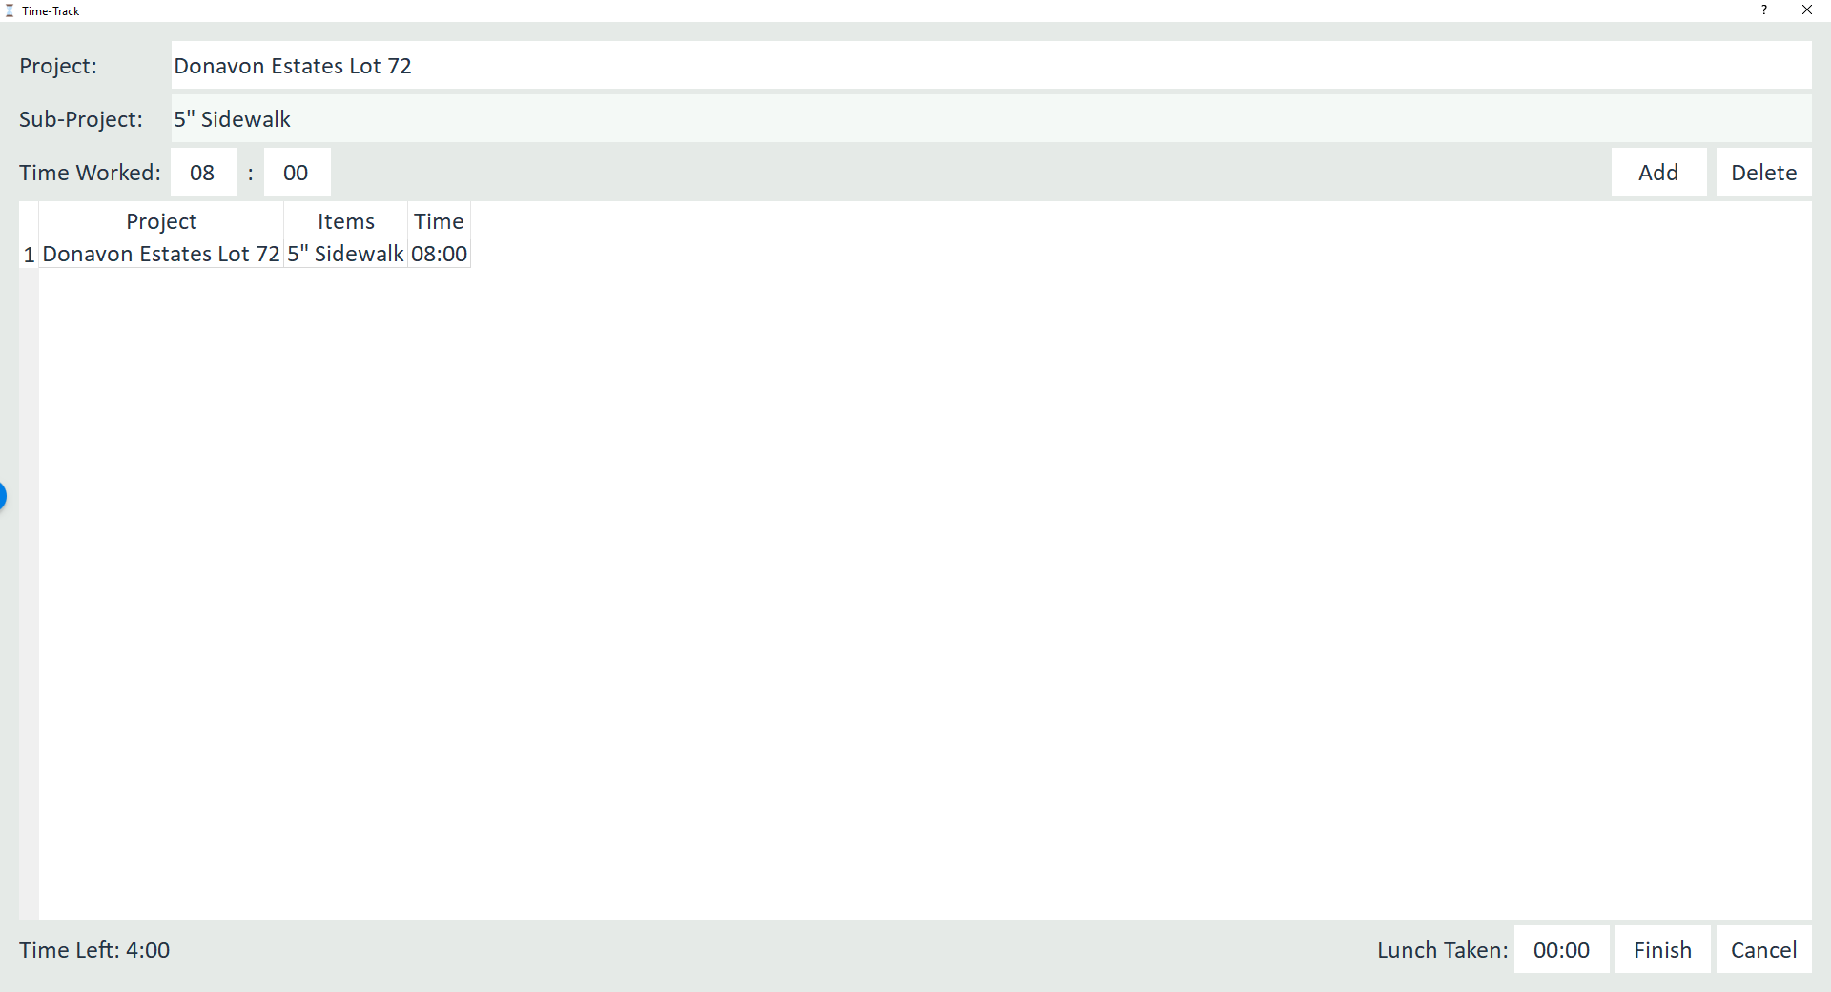
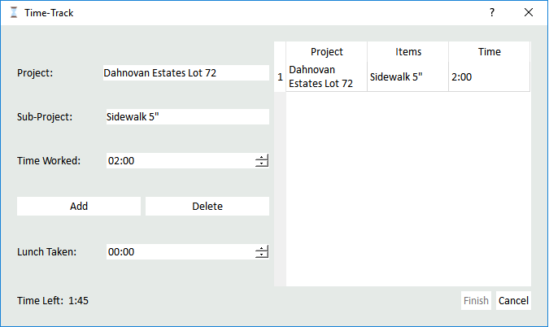
Now our 5” Sidewalk is there
Notice that we added 8:00
This leaves 4:00 in “Time Left”

Slide 12

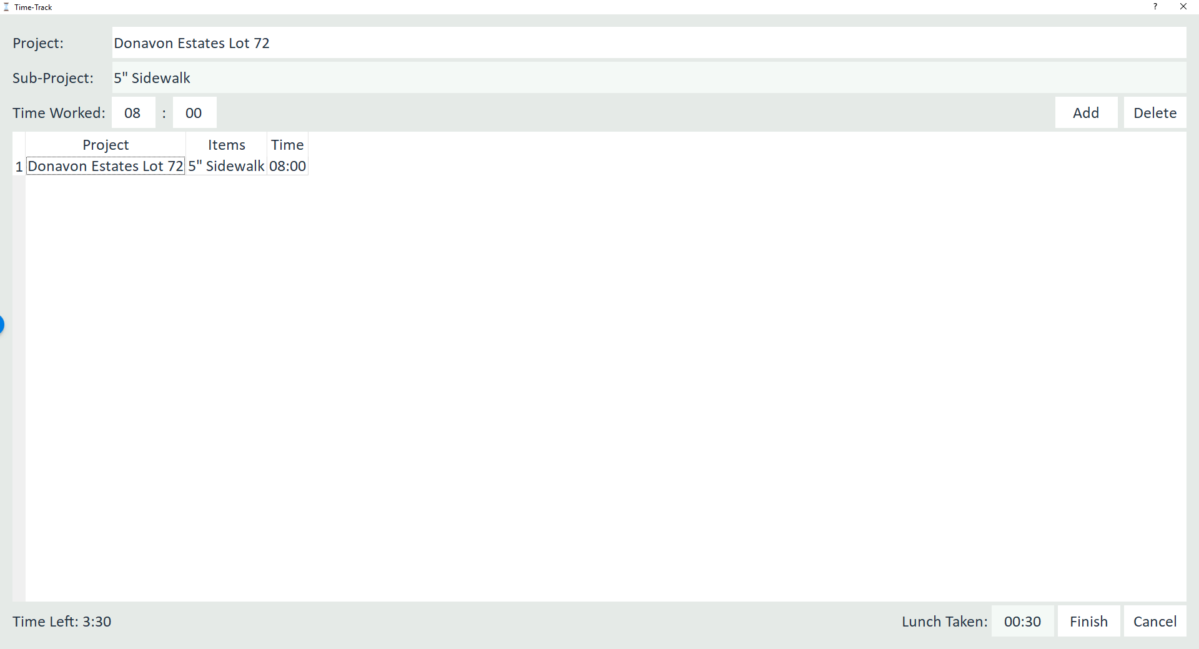

If you did have a Lunch you can add that here
And it is then taken off your “Time Left”

Slide 13
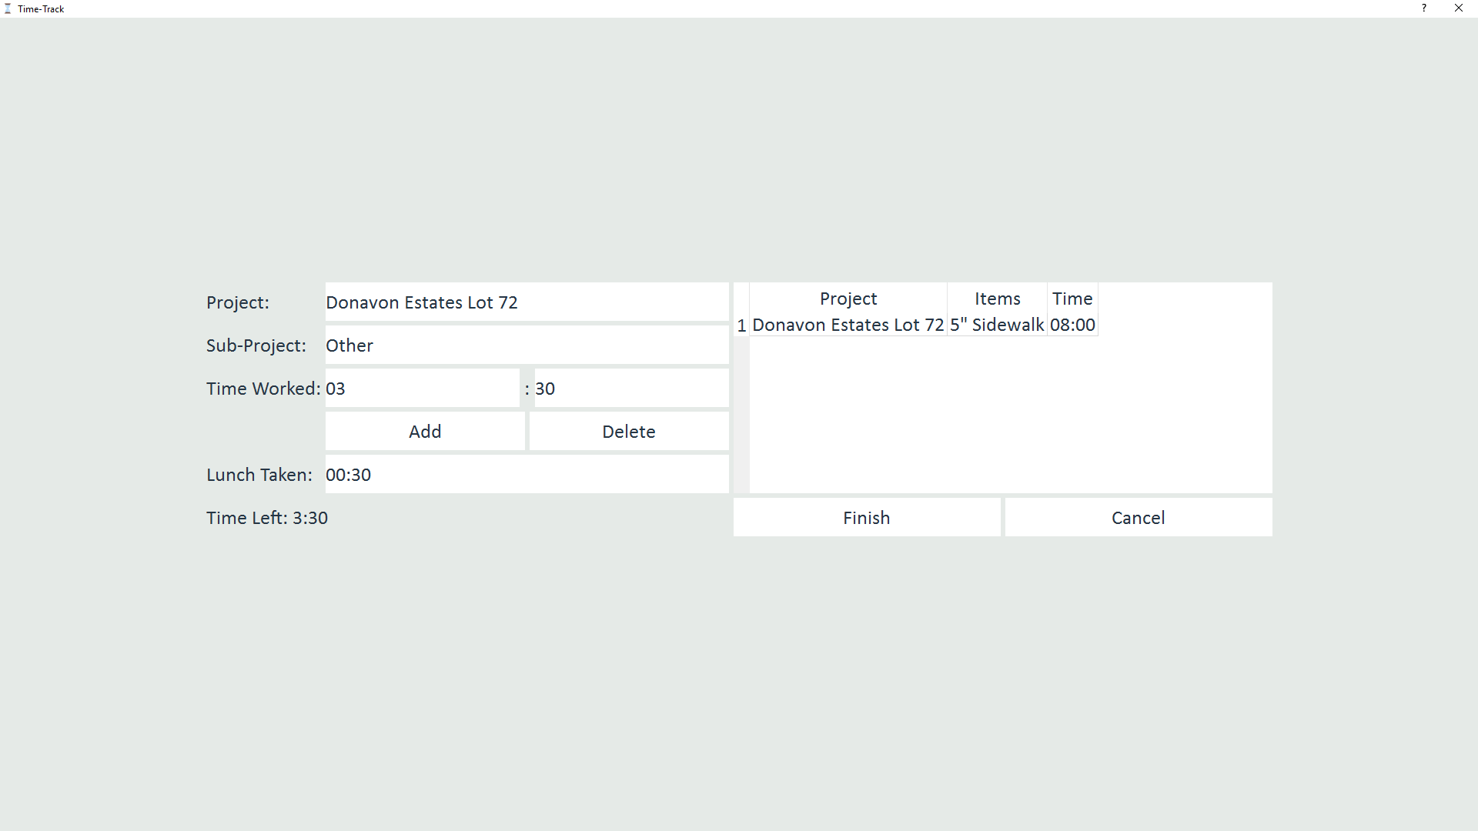
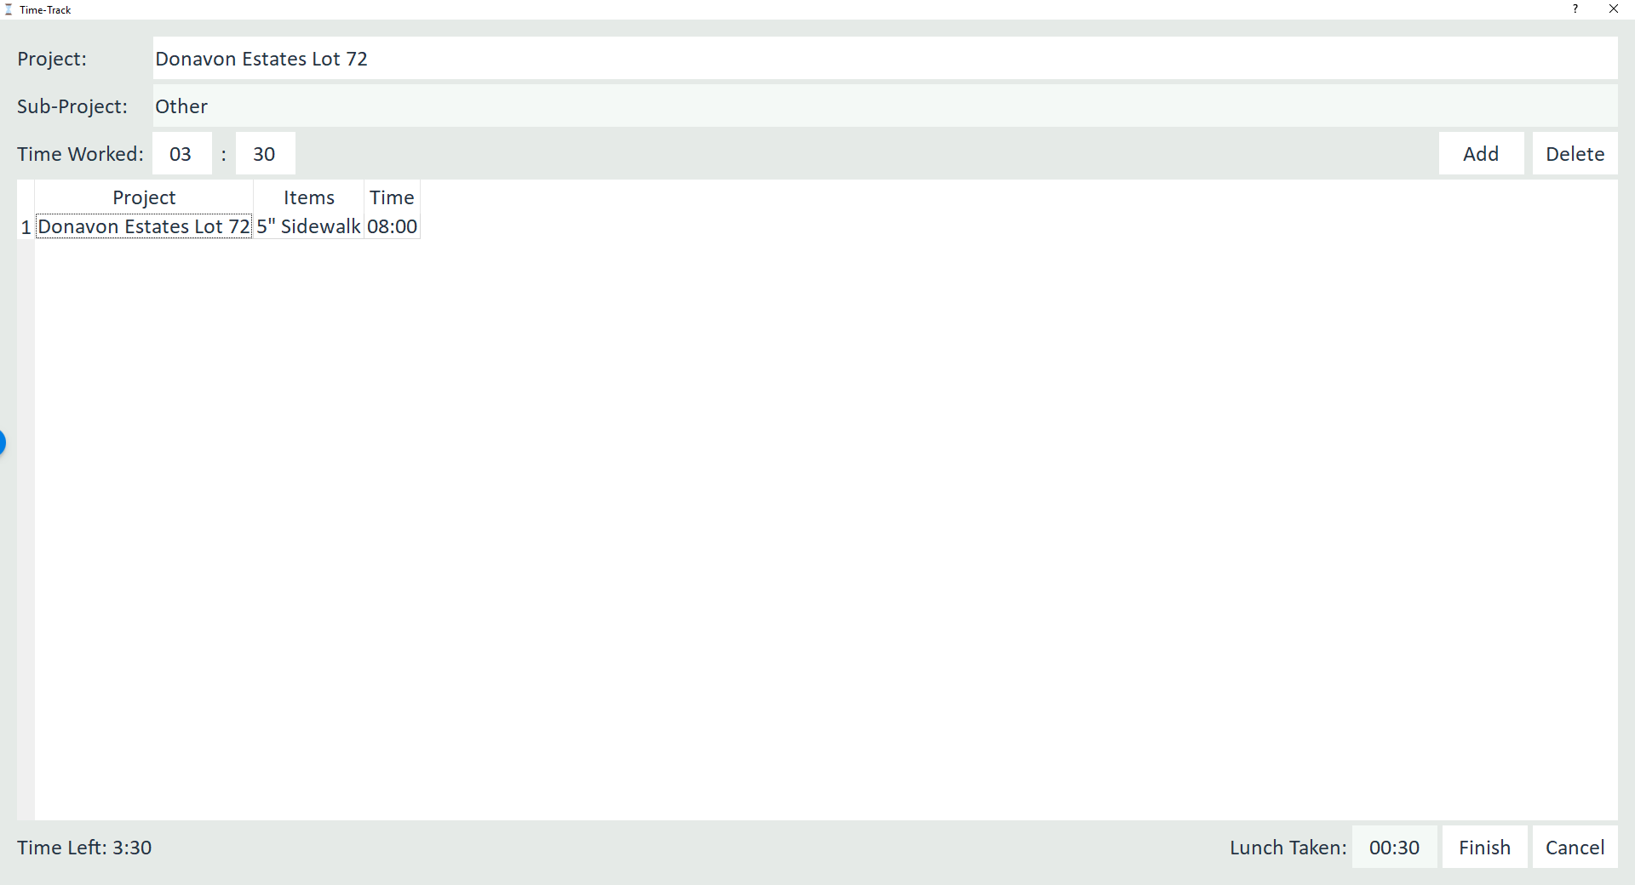
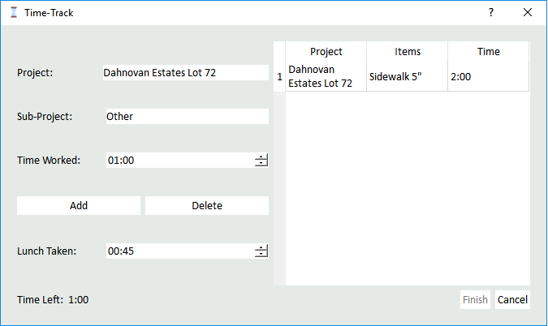
If you ever find that what you did is not in the Sub-Projects box select the Other option
Click Add to Add this info to your time card

Slide 14
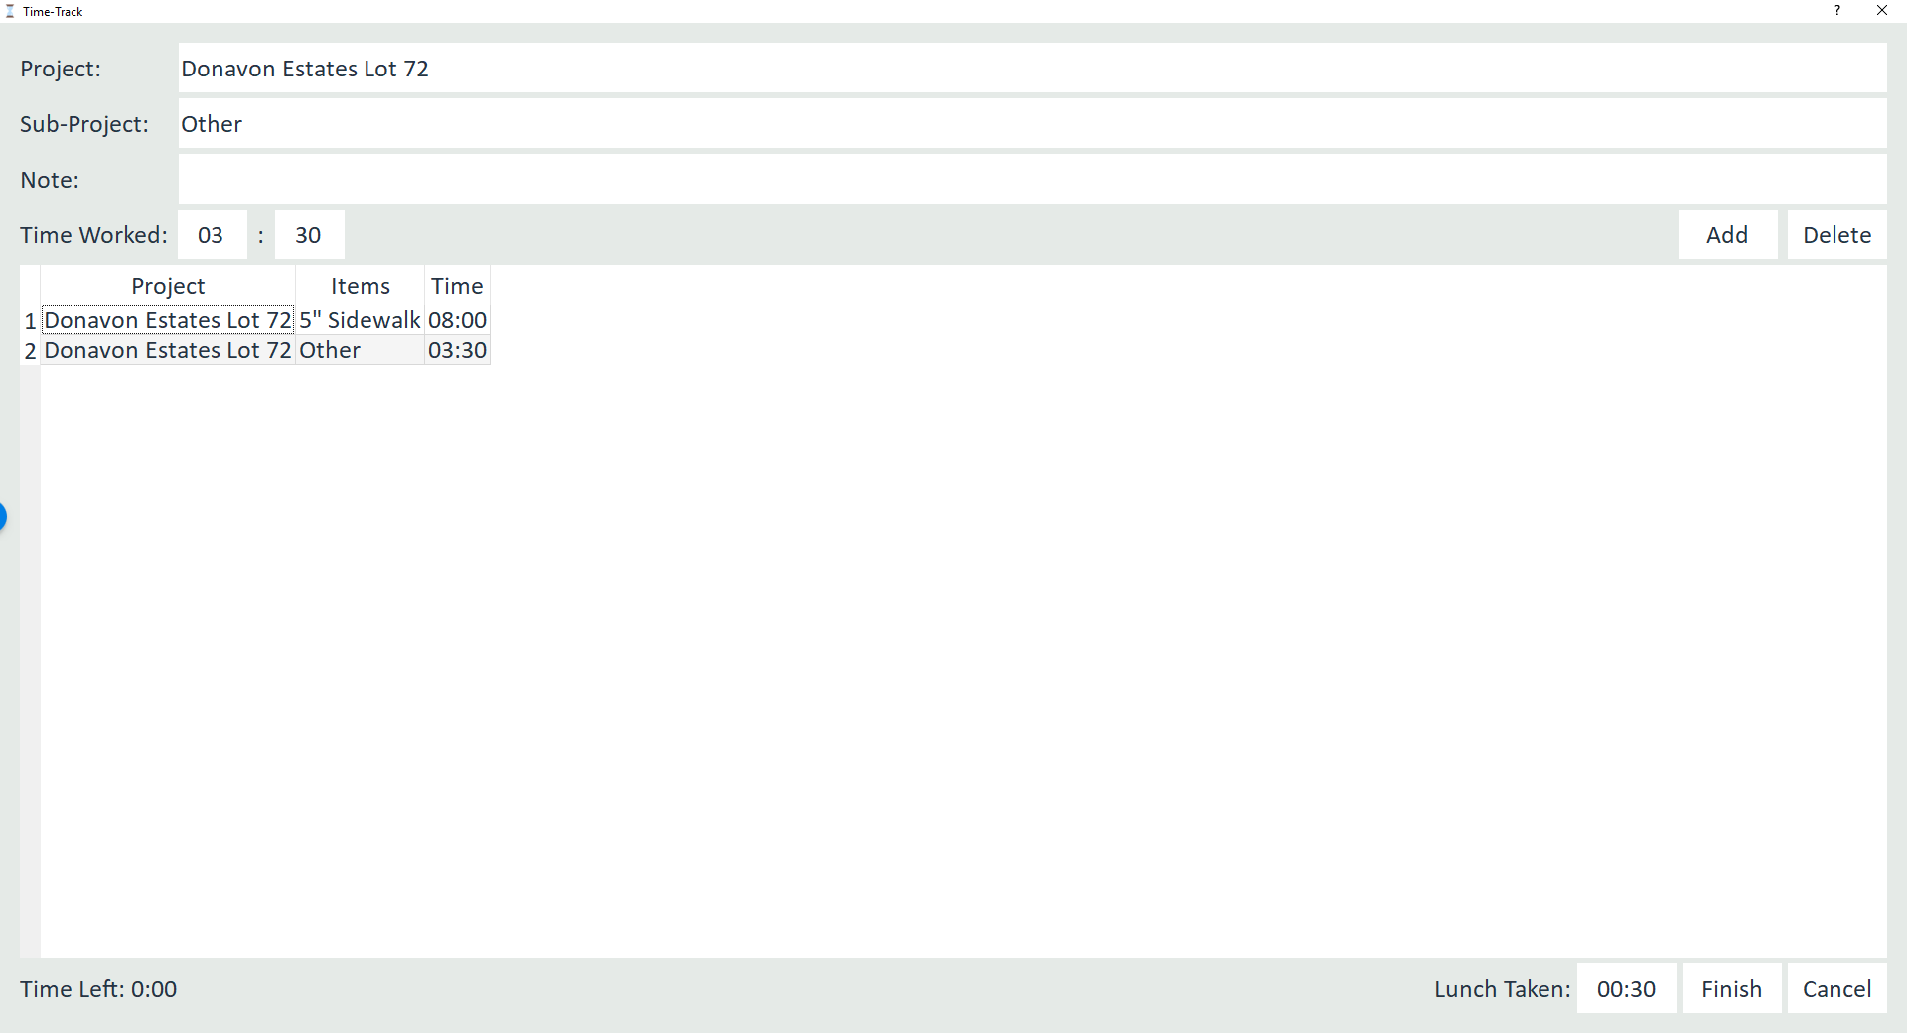
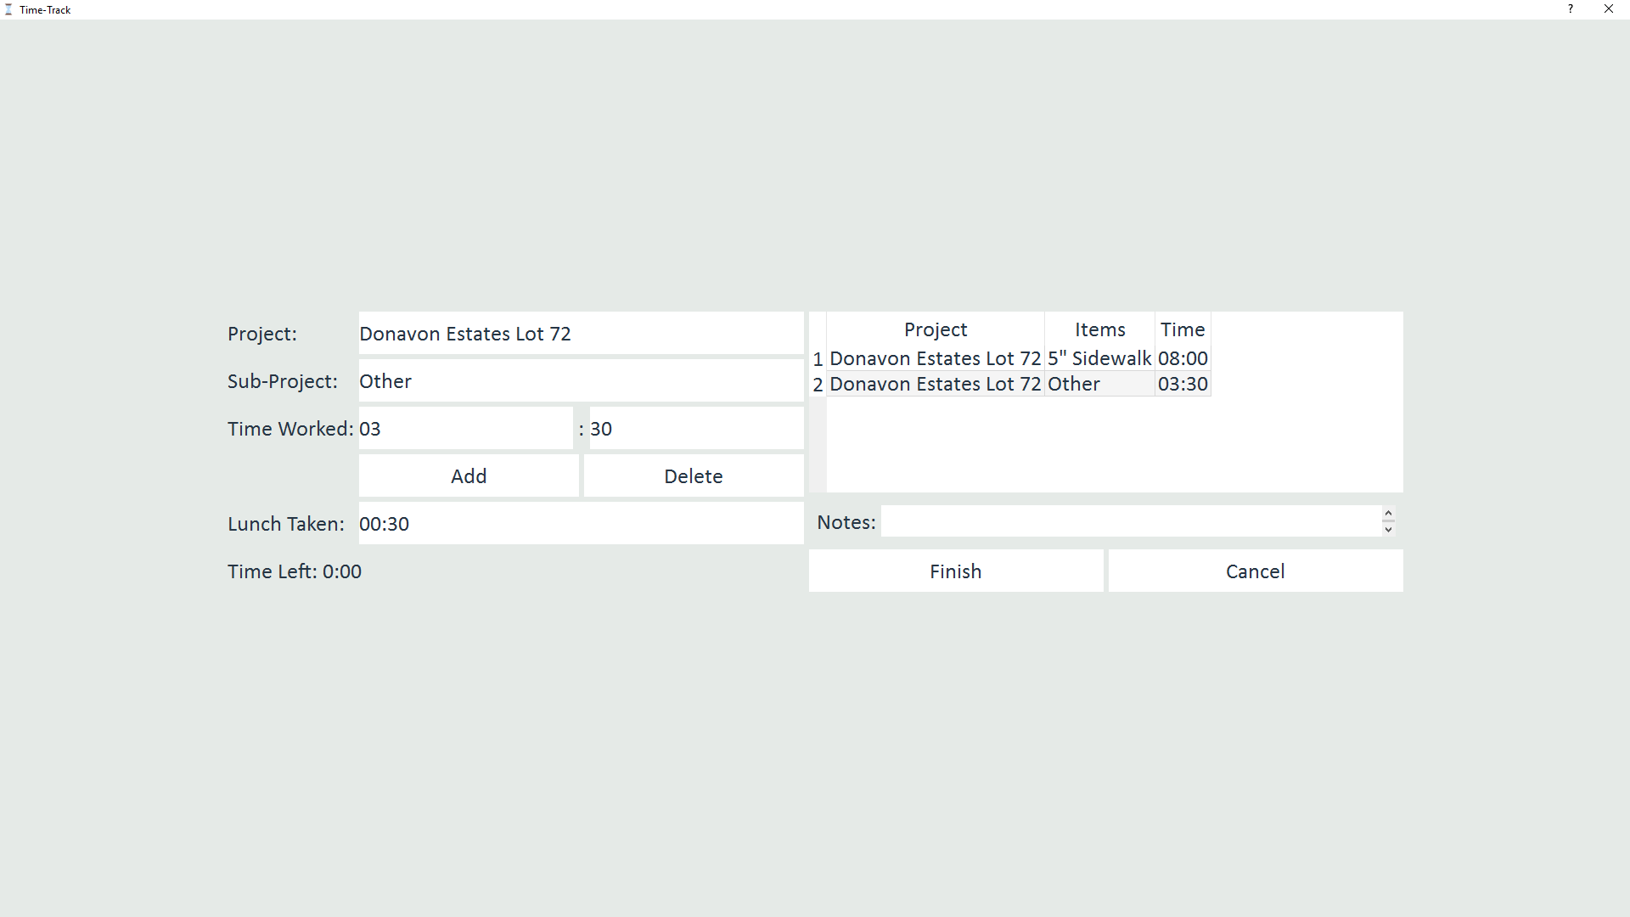
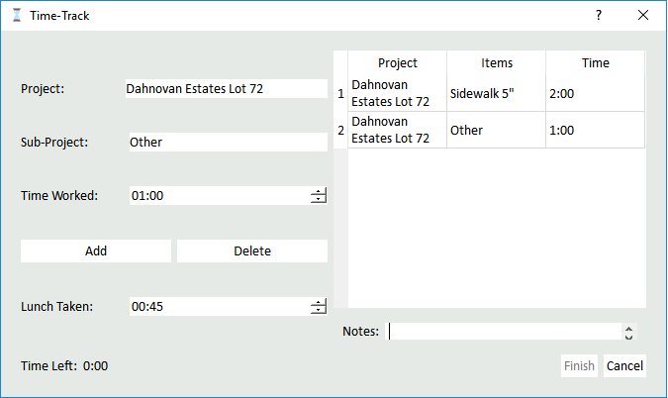
Now this time can be seen here
Adding a Other Sub-Project to your time card automatically provides you with a place to describe what you did

Slide 15
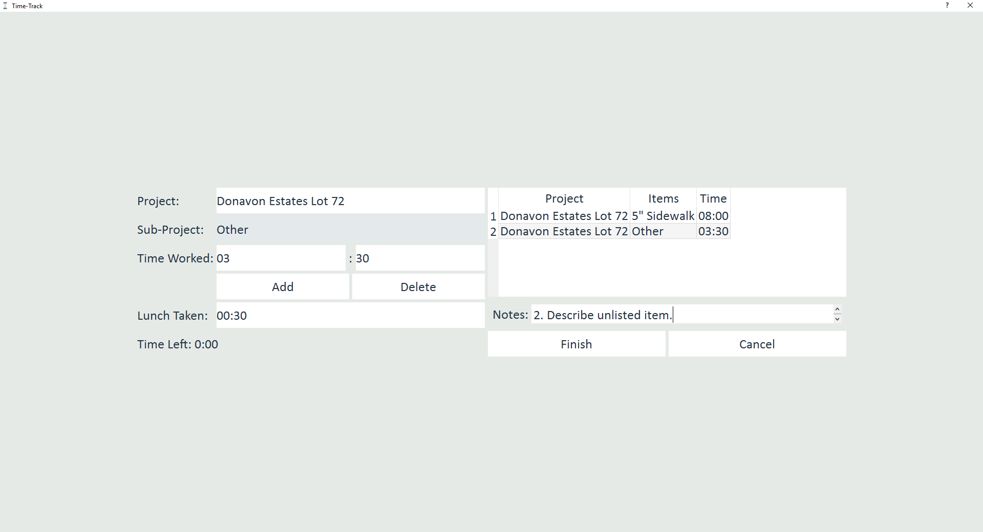
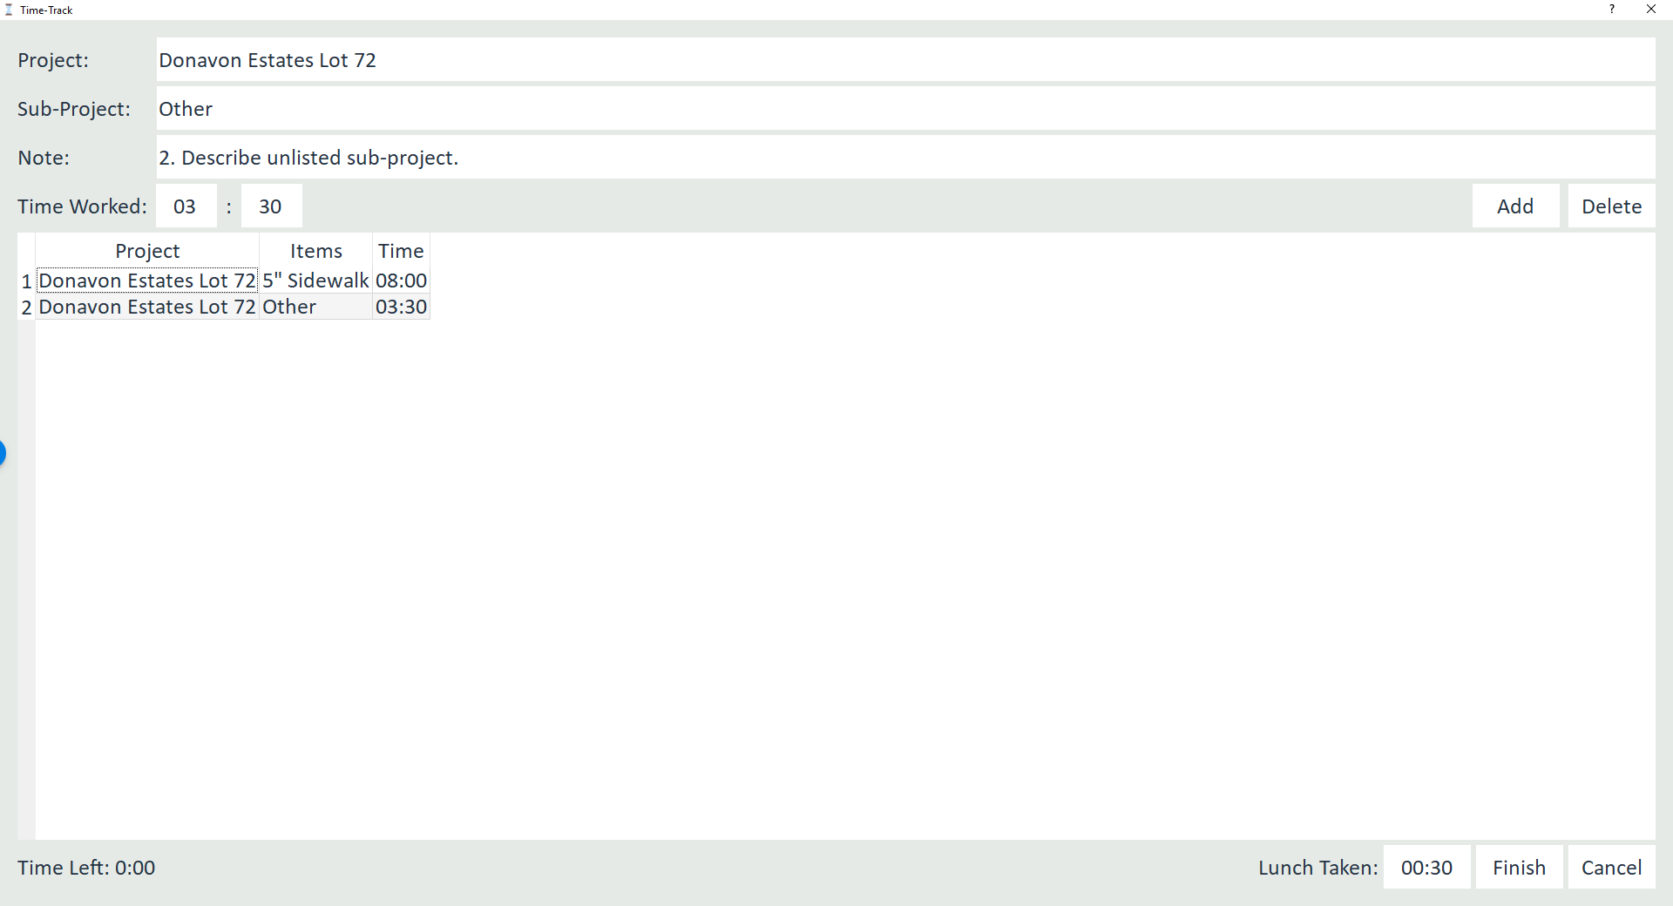
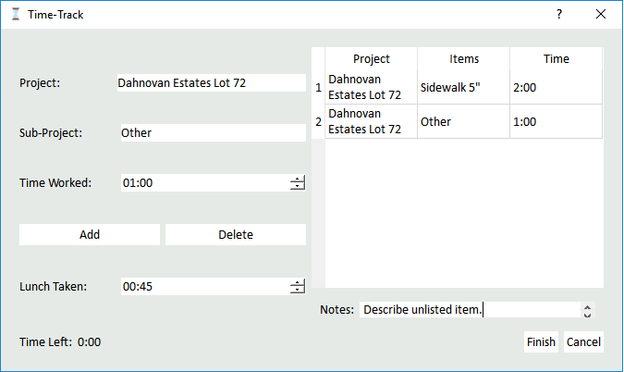
Before you finish:
Time Left must be 0:00
The Notes Section must be filled out (if you have an Other Sub-Project)
Include a number label that matches the item. This will help when there is more that one note.
Click Finish

Slide 16
Now just click Finish again

Slide 17
And it is ready to go for the next guy

Slide 18
If you forget to Clock out

Slide 19
You Should Clock Out, and Clock back In

Slide 20
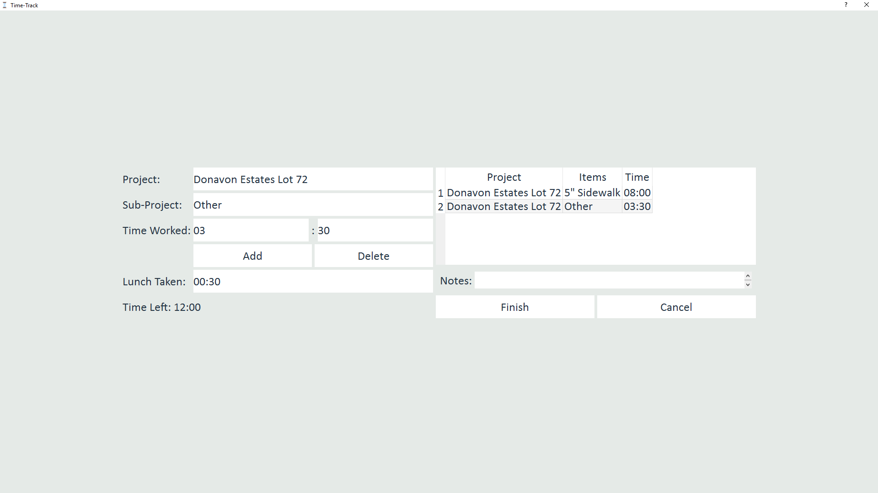
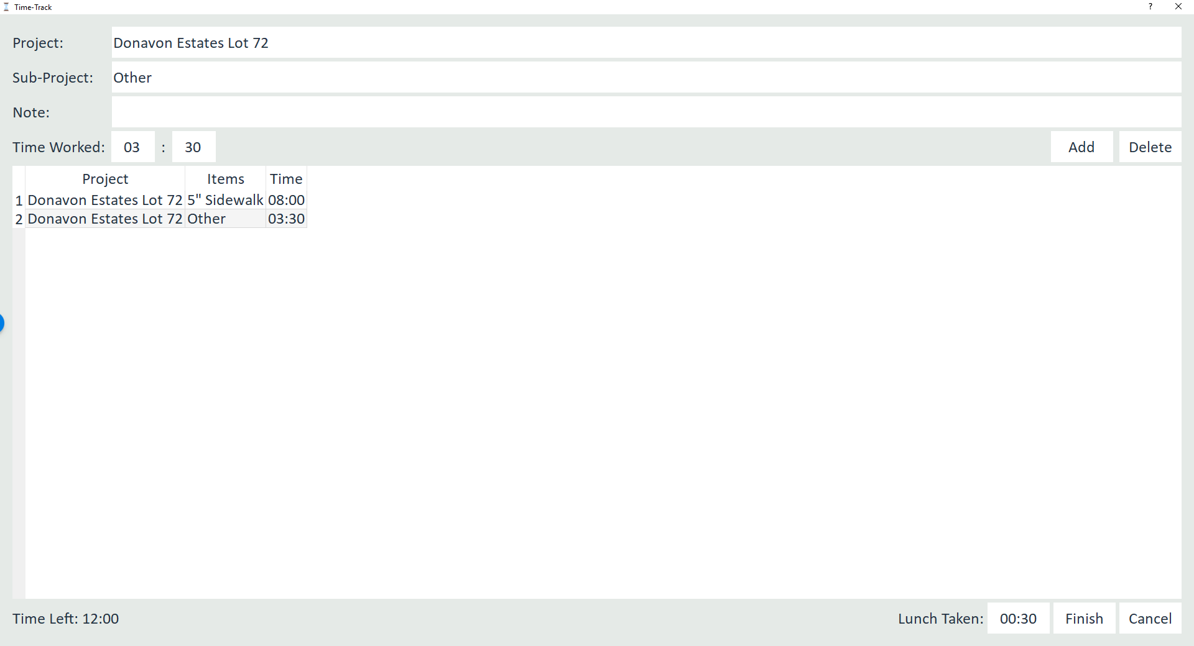
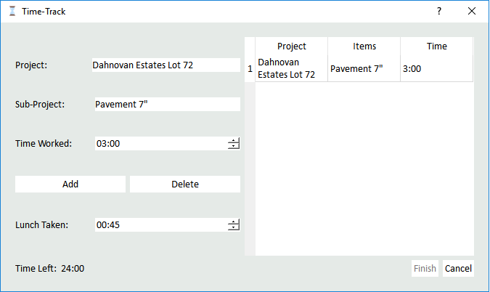
When clocking out do so as you would normally(Pg7)
Notice the Extra Time

Slide 21
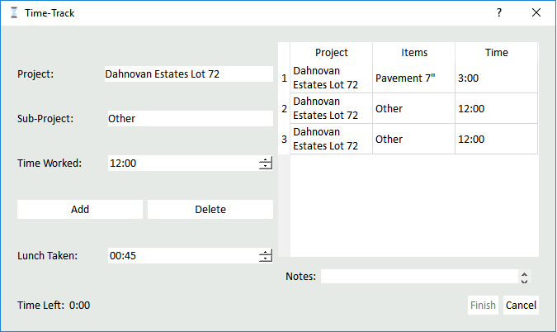
Now put the Extra Time in a Other Item
Note that this box only goes up to 12 hours. So if you have over 12 hours of extra time you might have more than one extra shift to describe it

Slide 22
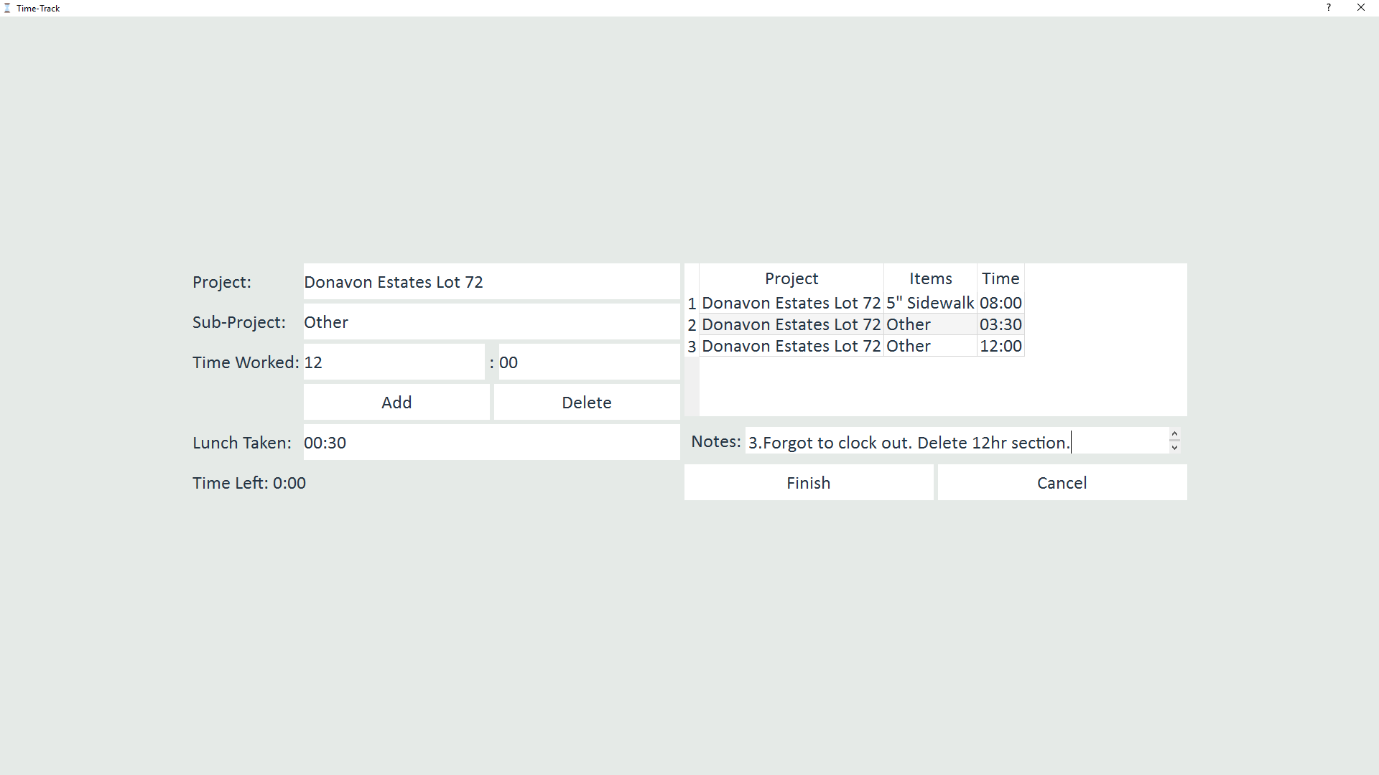
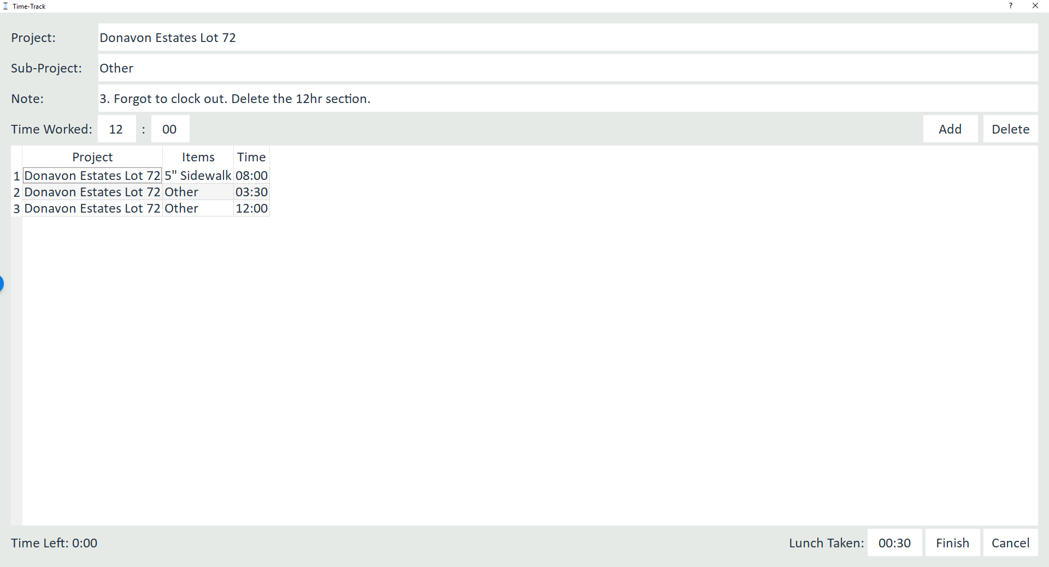
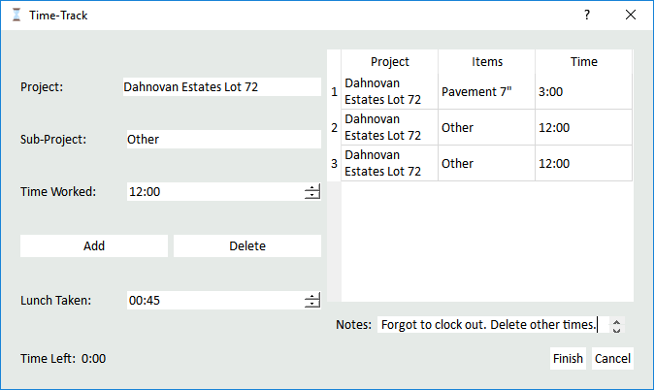
Then to finish fill in the Notes section with something like this
Don’t forget to match the numbering!
Click Finish

Slide 23
Now Clock In for today
And click Finish again

Slide 24
Notes
When you forget to Clock Out make sure to be accurate with your correction because It will be compared to other times recorded from your crew.

